Slide 1
Computer System Design & Application
计算机系统设计与应用A
陶伊达 （TAO Yida）
taoyd@sustech.edu.cn
TAO Yida@SUSTECH
1

Slide 2

Lecture 8
Network Basics
Network Protocols
Socket Programming
Getting Web Data
TAO Yida@SUSTECH
1

Slide 3




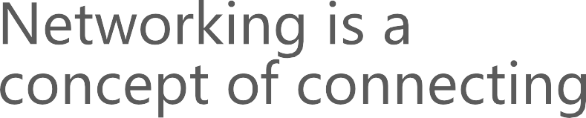
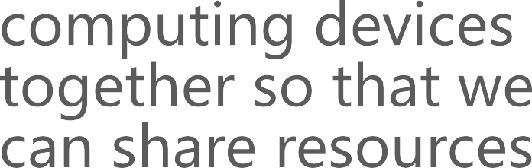
Networking

Slide 4
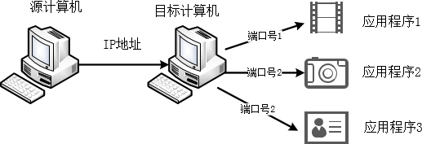
Networking Terminology
IP address: a unique address that distinguishes a device on the internet or a local network
Domain name: a human-friendly version of an IP address that you enter in browser (translated by DNS)
Port number: a number used to identify
different applications/processes uniquely
TAO Yida@SUSTECH
5

Slide 5
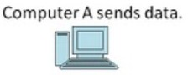
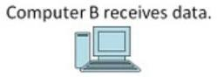
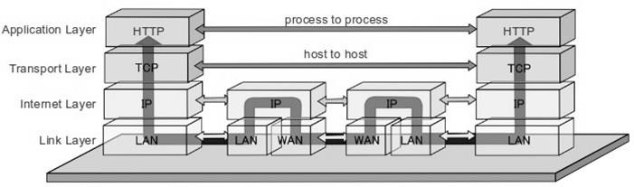
Network Architecture
Network architecture refers to a network’s structural and logical layout. It describes how the network devices are connected and the rules that govern data transfer between them
https://www.elprocus.com/tcp-ip-protocol-architecture-and-its-layers/
TAO Yida@SUSTECH
8

Slide 6

How do devices communicate with each other?
10
TAO Yida@SUSTECH

Slide 7
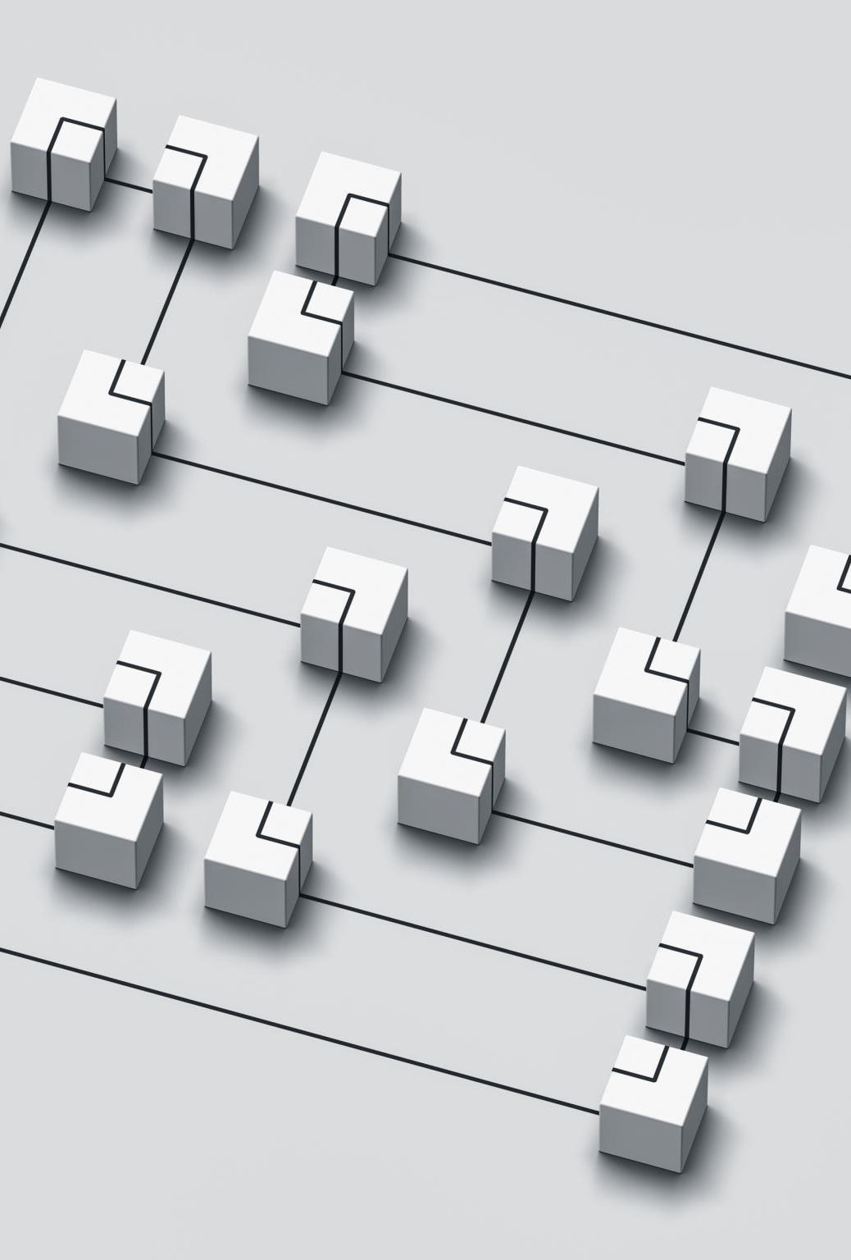
Network Protocols
A network protocol (网络协议) is a set of established rules that dictate how to format, transmit and receive data so that computer network devices can communicate, regardless of the differences in their underlying infrastructures, designs or standards.
To successfully send and receive information, devices on both sides of a communication exchange must accept and follow protocol conventions
Without computing protocols, computers and other devices would not know how to engage with each other.
TAO Yida@SUSTECH
11

Slide 8
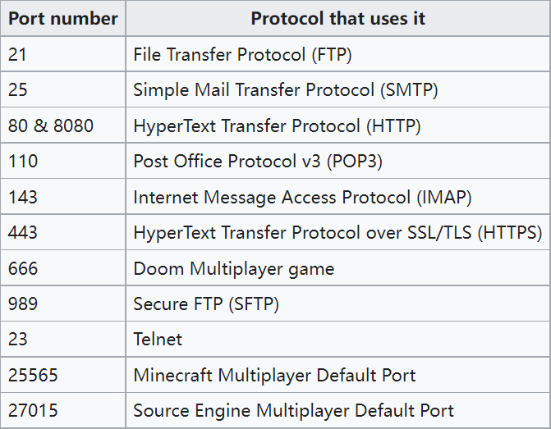
Application Layer Protocols
Each Internet application has a different application protocol, which describes how the data for that particular application are transmitted.
A port number helps a computer decide which application should receive an incoming piece of data
Well-known port numbers are reserved and
we can no longer use them for other purposes
TAO Yida@SUSTECH

Slide 9
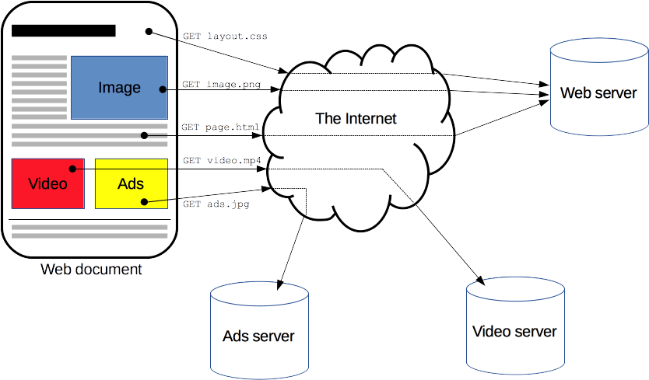
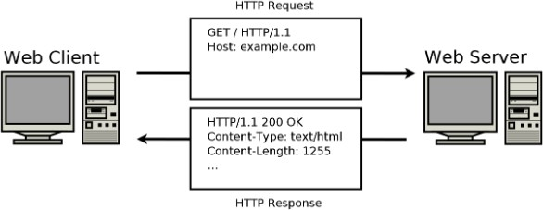
HTTP (Hypertext Transfer Protocol)
HTTP is a protocol for fetching resources such as HTML documents. It is the foundation of any data exchange on the Web
It is a client-server protocol, which means requests are initiated by the client, usually the web browser.
Web server responds with an HTTP response
https://developer.mozilla.org/en-US/docs/Web/HTTP/Overview
TAO Yida@SUSTECH

Slide 10
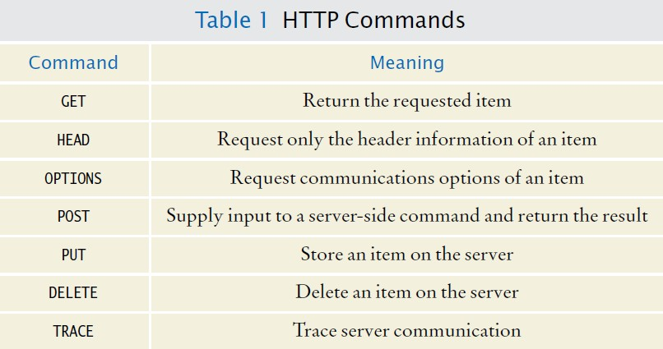
HTTP
Request Commands

Slide 11
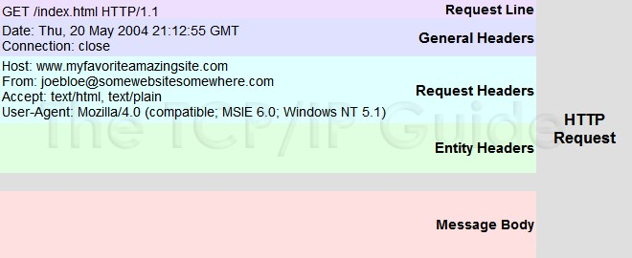
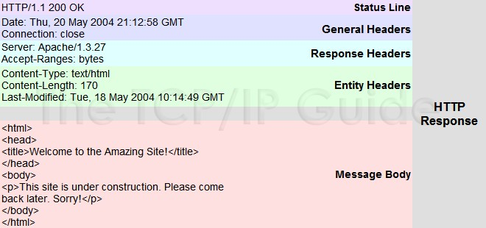
HTTP
Request/Response Message Format
http://www.tcpipguide.com/free/t_HTTPResponseMessageFormat.htm
TAO Yida@SUSTECH
15

Slide 12
TCP (Transmission Control Protocol)
TCP provides a reliable, point-to-point communication channel for clients and servers to communicate over the Internet
TCP is the protocol used most on top of IP, we often referred to as TCP/IP
UDP (User Datagram Protocol)
contains a minimum amount of communication mechanisms (no acknowledgement, unreliable)
Transport Layer Protocols
https://www.elprocus.com/tcp-ip-protocol-architecture-and-its-layers/
TAO Yida@SUSTECH
16

Slide 13
Lecture 8
Network Basics
Network Protocols
Socket Programming
Getting Web Data
TAO Yida@SUSTECH
17

Slide 14
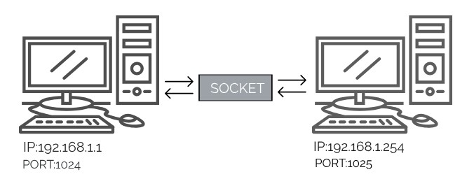
To communicate, a client program and a server
program establish a connection to one another
Each program binds a socket to its end of the connection
A socket is one endpoint of a two-way communication link between two programs running on the network.
Endpoint: IP address + Port number
To communicate, the client and the server each reads from and writes to the socket bound to the connection.
Socket
https://examradar.com/java-networking-network-basics-socket-overview/
TAO Yida@SUSTECH
18

Slide 15
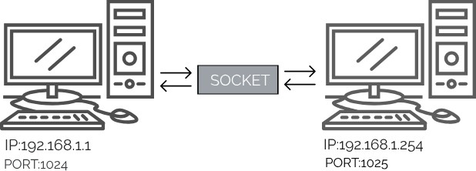
The java.net package provides a powerful and flexible infrastructure for networking, providing various classes and interfaces that execute the low- level communication features
Socket
https://examradar.com/java-networking-network-basics-socket-overview/
TAO Yida@SUSTECH
19

Slide 16
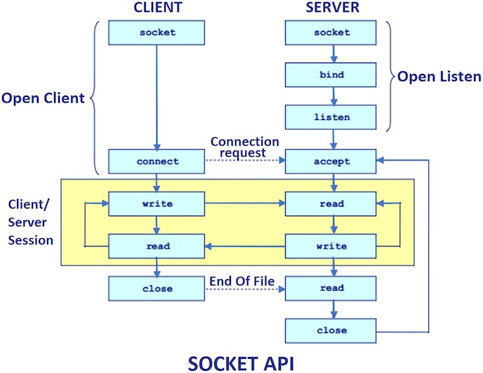
Socket s = new Socket(“www.serverip.com”, 1234);
ServerSocket ss = new ServerSocket(1234); Socket s = ss.accept();
What if the server and client run on the same machine?
Create an instance of Socket by passing the IP or hostname of the server and a port number
If the connection fails, an Exception is thrown
Otherwise, establish the connection and use Socket s to read and write.
Create an instance of ServerSocket by binding to 1234 port number
The accept() method waits until a client connects to port 1234, and if so, return an instance of Socket that is used for reading and writing.
https://www.javatpoint.com/socket-programming
TAO Yida@SUSTECH

Slide 17
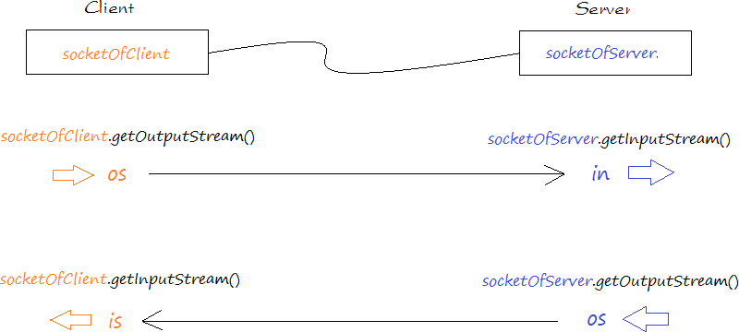
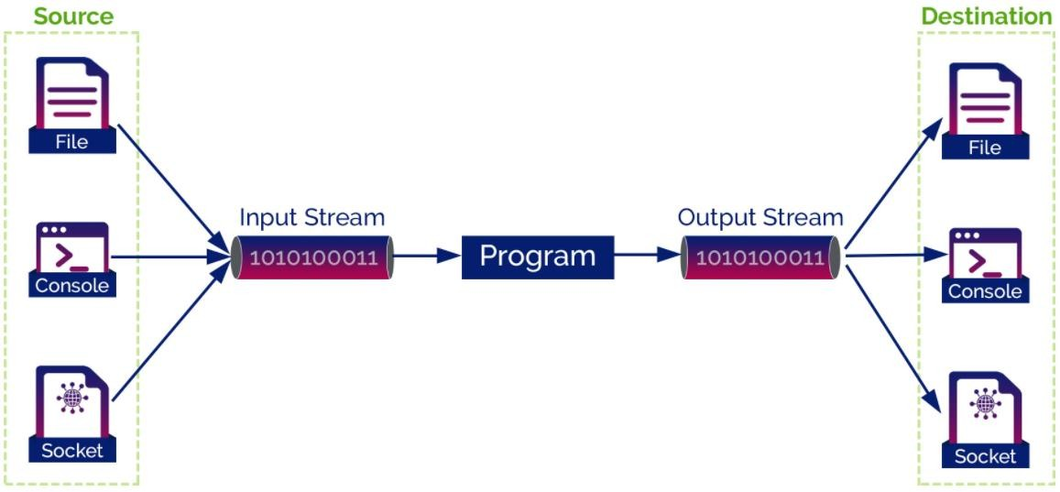
After establishing the connection, we can use socket.getInputStream() and socket.getOutputStream() for both the client and the server
Reading from and Writing to a Socket
Write
Read
Read
Write
TAO Yida@SUSTECH

Slide 18
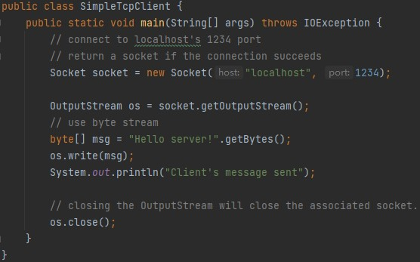
A Toy Example: Client

Slide 19
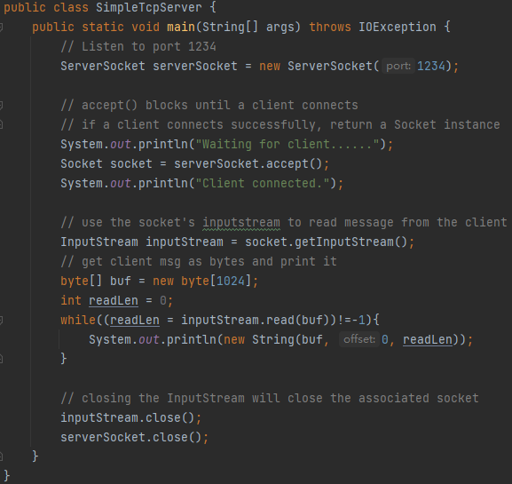
A Toy Example: Server

Slide 20
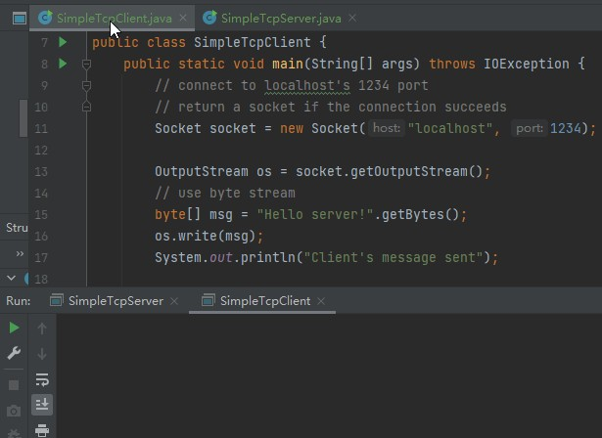
A Toy Example

Slide 21
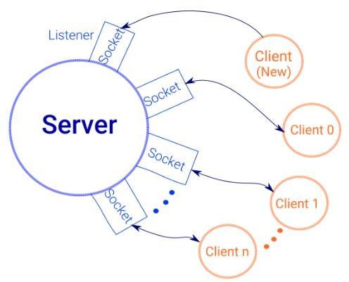
Why “Toy” Examples?
The toy server reads only 1 message then exits; In practice, server keeps running
The toy client/server handles byte directly,
which is cumbersome
In practice, servers need to support multiple clients at the same time
More practical: We could use threads on server side: whenever a client request comes, a separate thread is assigned for handling each request
TAO Yida@SUSTECH

Slide 22
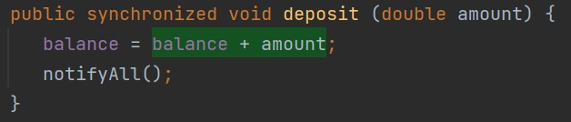
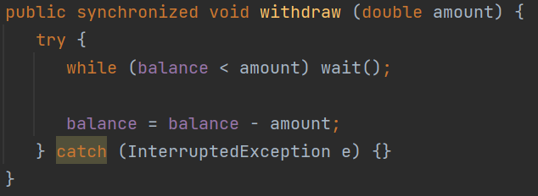
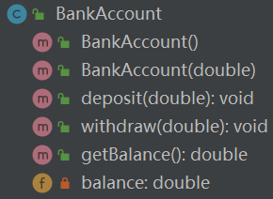
A bank account has a balance that can be changed by deposits and withdrawals.
Case Study: Banking Service
Wakes up all threads that are waiting on this object's monitor.
Causes the current thread to wait until another thread invokes the notify() method or the notifyAll() method for this object.
deposit() and withdraw() are properly synchronized
TAO Yida@SUSTECH

Slide 23
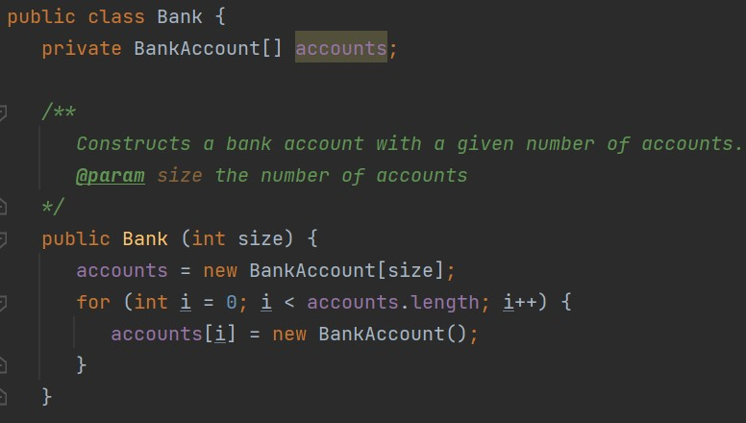
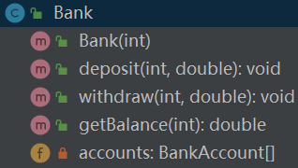
A bank has multiple bank accounts
A bank can withdraw from or deposit to a certain account
Case Study: Banking Service
TAO Yida@SUSTECH

Slide 24
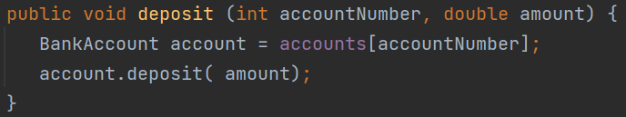
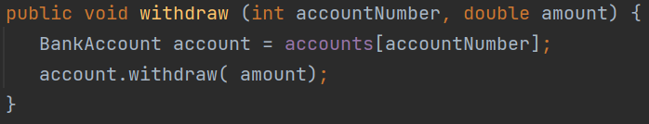
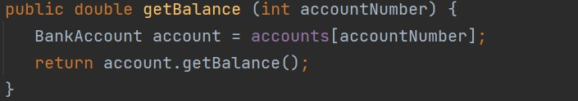
A bank has multiple bank accounts
A bank can withdraw from or deposit to a certain account
Case Study: Banking Service
TAO Yida@SUSTECH

Slide 25

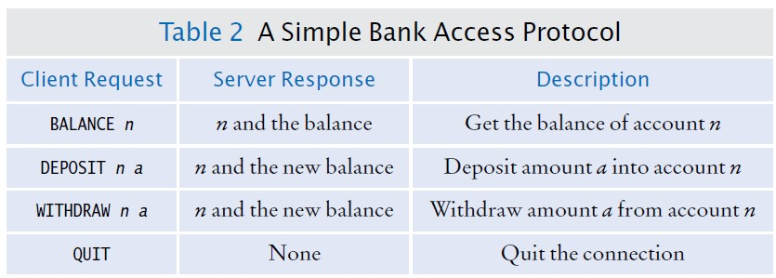
Banking Service Protocol
Whenever you develop a server application, you need to specify some application-level protocol that clients can use to interact with the server
TAO Yida@SUSTECH
29

Slide 26
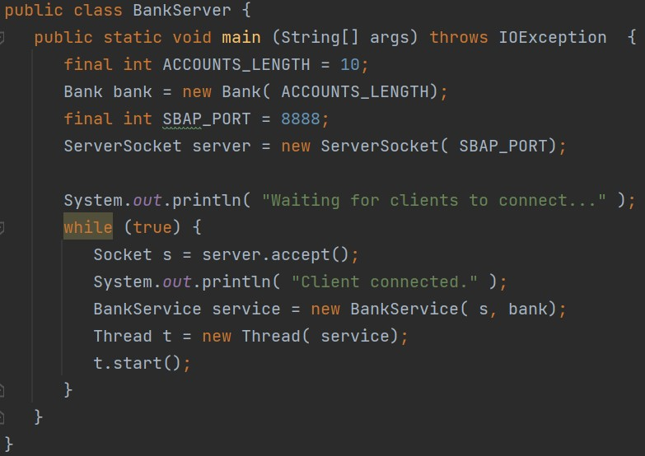
Bank Server

Slide 27
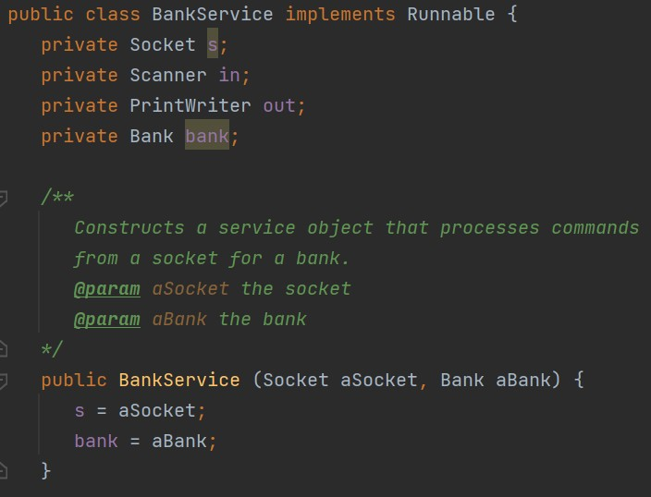
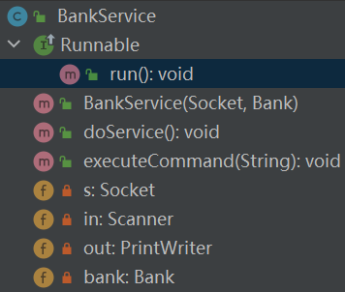
A bank service executes the banking service protocol
Case Study: Banking Service
TAO Yida@SUSTECH

Slide 28
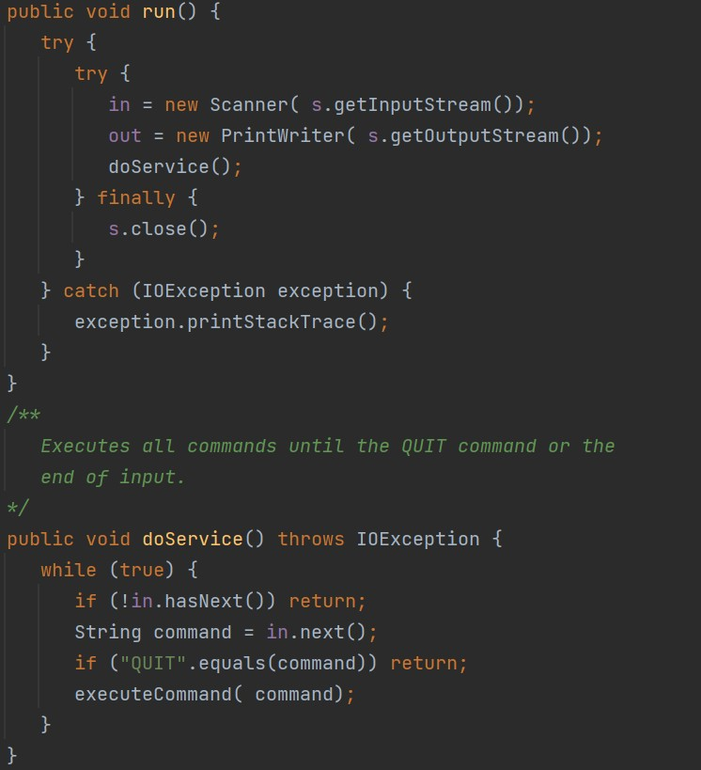
Case Study: Banking Service
TAO Yida@SUSTECH

Slide 29
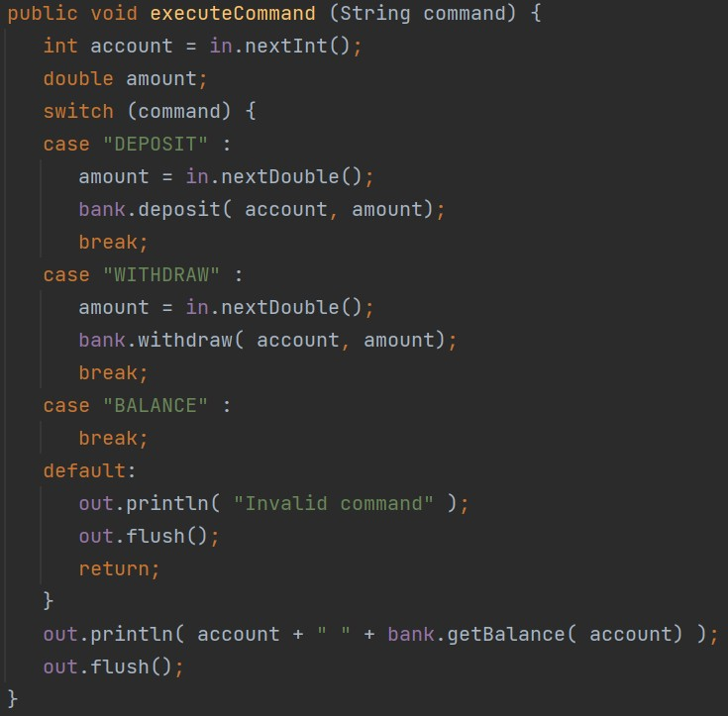
Case Study: Banking Service
TAO Yida@SUSTECH

Slide 30
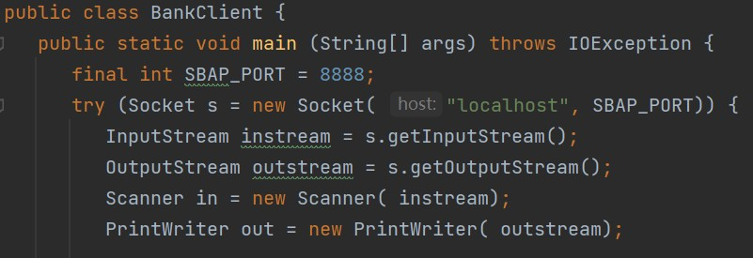
Bank Client
To communicate with the server by sending and receiving text, you could turn the streams into scanners and writers
TAO Yida@SUSTECH

Slide 31
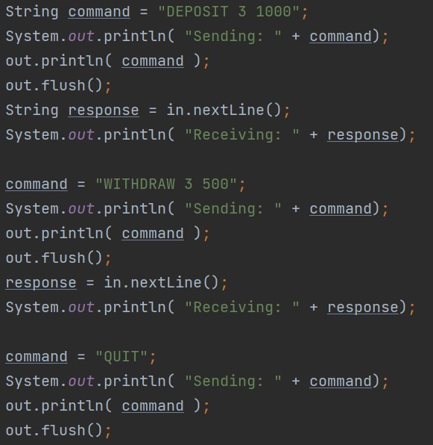
Bank Client
The flush method empties the buffer and forwards all waiting characters to the destination.
TAO Yida@SUSTECH

Slide 32
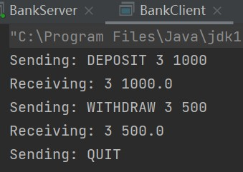
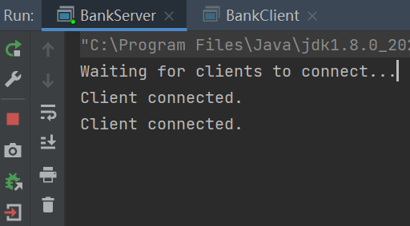
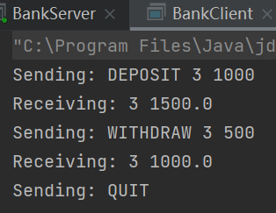
Case Study
Server keeps running ……
TAO Yida@SUSTECH

Slide 33
Lecture 8
Network Basics
Network Protocols
Socket Programming
Getting Web Data
java.net package
Web scraping libraries
REST API
TAO Yida@SUSTECH

Slide 34
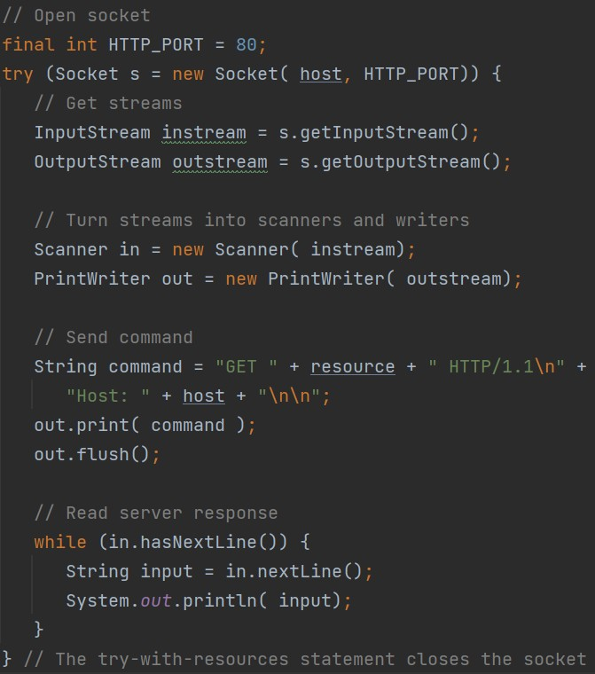
Fetching a web page with socket
The client establish a Socket with the server. The socket constructor throws an UnknownHostException if it can’t find the host.
InputStream and OutputStream classes are used for reading and writing bytes. If you want to communicate with the server by sending and receiving text, you should turn the streams into scanners and writers
A print writer buffer characters. We need to flush the buffer manually so that the server get a complete request
Receive responses from the server
TA
O Yida@SUSTECH
39

Slide 35
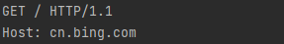
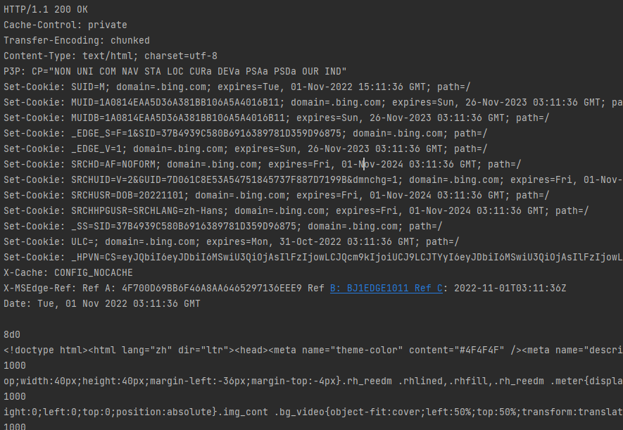
Fetching a web page with socket
TAO Yida@SUSTECH
40

Slide 36
Fetching a web page with socket
Problems
We have to handle socket connections and socket errors by ourselves
We have to manually create HTTP requests with the correct format
We have to manually parse HTTP responses
To access web servers in Java, we want to work at a higher level than socket connections and HTTP requests
TA
O Yida@SUSTECH
41

Slide 37
URLConnection
Java contains a URLConnection class (java.net package), which provides convenient support for the HTTP
The URLConnection class takes care of the socket connection, so you do not have to fuss with sockets when you want to retrieve from a web server.
As an additional benefit, the URLConnection class can also handle FTP, the file transfer protocol.
TAO Yida@SUSTECH
42

Slide 38
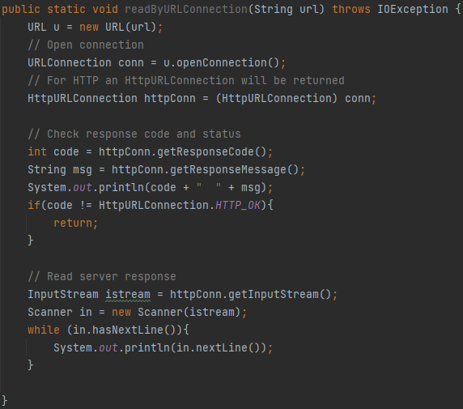
Fetching a web page with URLConnection
String url = "https://www.sustech.edu.cn";
TAO Yida@SUSTECH 43

Slide 39
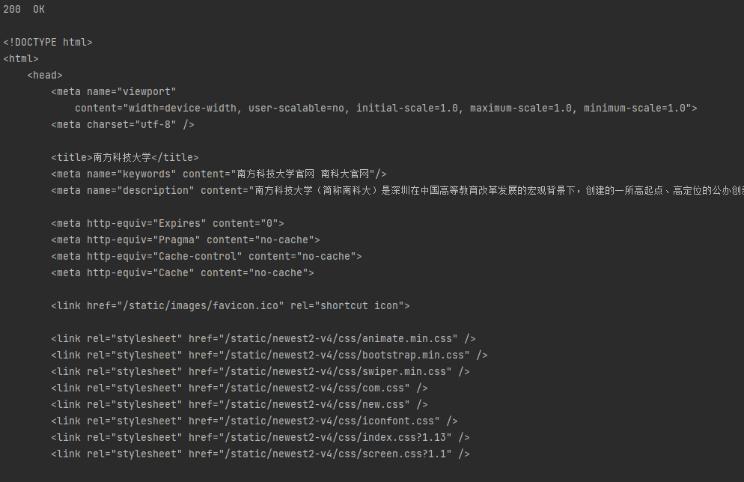
Fetching a web page with URLConnection
String url = "https://www.sustech.edu.cn";
TAO Yida@SUSTECH
44

Slide 40
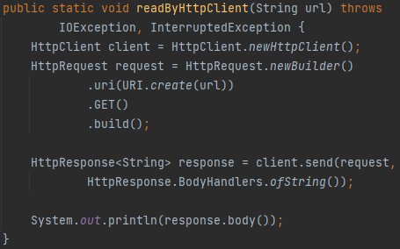
simpler way to connect to a web server (Java 11)
The java.net.http.HttpClient API provides an even
Fetching a web page with HttpClient

Slide 41
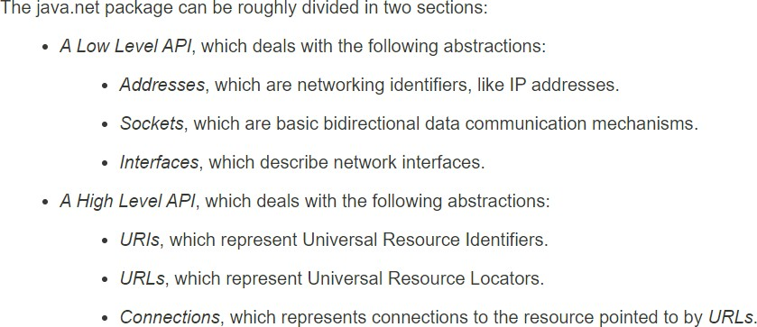
java.net package
Provides the classes for implementing networking applications.
https://docs.oracle.com/javase/7/docs/api/java/net/package-summary.html#package_description
TAO Yida@SUSTECH

Slide 42
Lecture 8
Network Basics
Network Protocols
Socket Programming
Getting Web Data
java.net package
Web scraping libraries
REST API
TAO Yida@SUSTECH

Slide 43

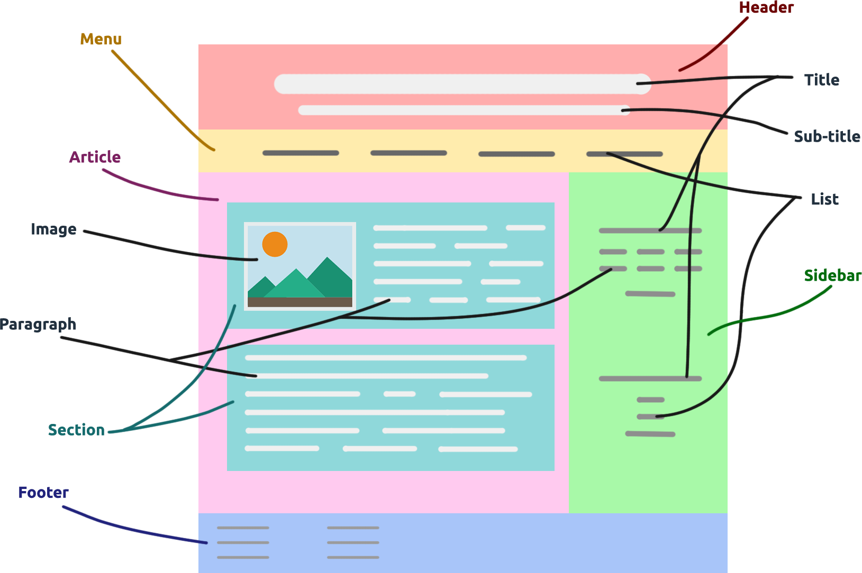
Web Scraping
Web scraping refers to the process of extracting of data from websites.
Typically using bots/spiders to automatically navigate through web pages and extract data
https://www.development-tutorial.com/basic-structure-html-page/
TAO Yida@SUSTECH
48

Slide 44
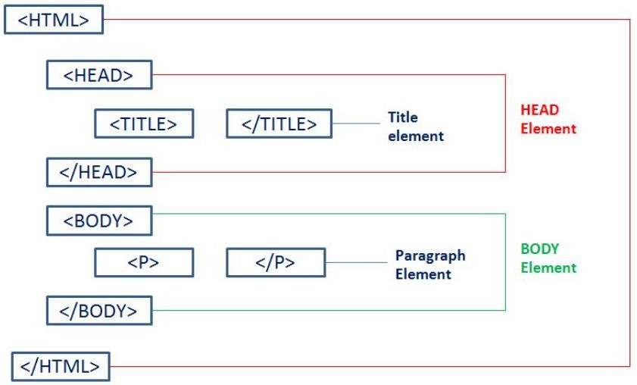
How are web pages created?
HTML (Hypertext Markup Language): a hypertext markup language for creating web pages
HTML uses tags for titles, headings, paragraphs, lists, tables, embedded images, etc., to describe the structure of a web page
https://www.etutorialspoint.com/index.php/basic-html/html-elements
TAO Yida@SUSTECH
49

Slide 45

Inspecting the HTML for an element
What if we want to find the html element for a specific part?
TAO Yida@SUSTECH
50

Slide 46

Inspecting the HTML for an element
TAO Yida@SUSTECH
51

Slide 47
Static vs Dynamic Web Pages
Static web pages
Server-side rendered HTML: web page is delivered to the user exactly as stored in the server
HTML is fixed
Dynamic web pages
JavaScript rendered HTML: web page content is created dynamically using JS
HTML is changing (e.g., scrolling down a web page to get the news feed)
Needs other advanced scraping strategy/libraries
TAO Yida@SUSTECH
52

Slide 48


Java Libraries for Web Scraping
1
Jsoup: this is a simple open- source library that provides very convenient functionality for extracting and manipulating data by using DOM traversal or CSS selectors to find data. It is beginner friendly.
2
HTMLUnit: is a more powerful framework that can allow you to simulate browser events such as clicking and forms submission when scraping and it also has JavaScript support.
3
Jaunt: can be used to extract data from HTML pages or JSON data payloads by using a headless browser. It has recently been updated to include JavaScript support.
TAO Yida@SUSTECH
53

Slide 49
Lecture 8
Network Basics
Network Protocols
Socket Programming
Getting Web Data
java.net package
Web scraping libraries
REST API
TAO Yida@SUSTECH
55

Slide 50

TAO Yida@SUSTECH
API
An interface for multiple programs to communicate with each other (e.g., public class and methods in java.net)
REST
REpresentational State Transfer
REST is a software architectural style
What is REST API?
REST API
A REST API is an API conforms to the constraints of REST architectural style
What are the constraints of REST style?
56

Slide 51

REST Constraints
Client-server: A client-server architecture made up of clients, servers, and resources (info like text, image, video)
Resources could be accessed using URL
Stateless: Resource requests should be made independently of one another
Requests are made using HTTP protocol
GET: get resources
POST: create resources
PUT/PATCH: update resources
DELETE: delete resources
TAO Yida@SUSTECH
57

Slide 52

Image source: https://www.altexsoft.com/blog/rest-api-design/
TAO Yida@SUSTECH

Slide 53
REST API Request Design
Request = Verb + Object
Typically use noun in plural form, e.g., questions
Allow parameters for filtering, e.g., ?limit=10
GET
PUT
PATCH
POST
DELETE
TAO Yida@SUSTECH

Slide 54





GitHub REST API
URL: https://api.github.com/
Documentation: https://docs.github.com/en/rest
Get a repository info by its owner and repo name
List repository contributors
Create an issue (must have pull access to this repo)
Update a release (must have push access to this repo)
Search for topics (should specify the topic using parameters)
TAO Yida@SUSTECH

Slide 55

Stack Overflow REST API
REST Service URL
Requested resource
Parameter
java.net package
Request verb
200
OK
gzip
TAO Yida@SUSTECH

Slide 56


Request Response
HTTP Status Code
JSON format
TAO Yida@SUSTECH

Slide 57

63
TAO Yida@SUSTECH
JavaScript Object Notation
An open data interchange format that is both human
and machine-readable
Independent of any programming language
JSON

Slide 58

JSON Helper Tools
Java Libraries for parsing and creating JSON string: JSON-simple, GSON, Jackson, etc.
JSON viewers (help formatting the JSON string)
TAO Yida@SUSTECH

Slide 59

Next Lecture
GUI Intro
JavaFX
TAO Yida@SUSTECH

